Slide 1
Unit 3.5
Teacher: iddo sadeh

Slide 2
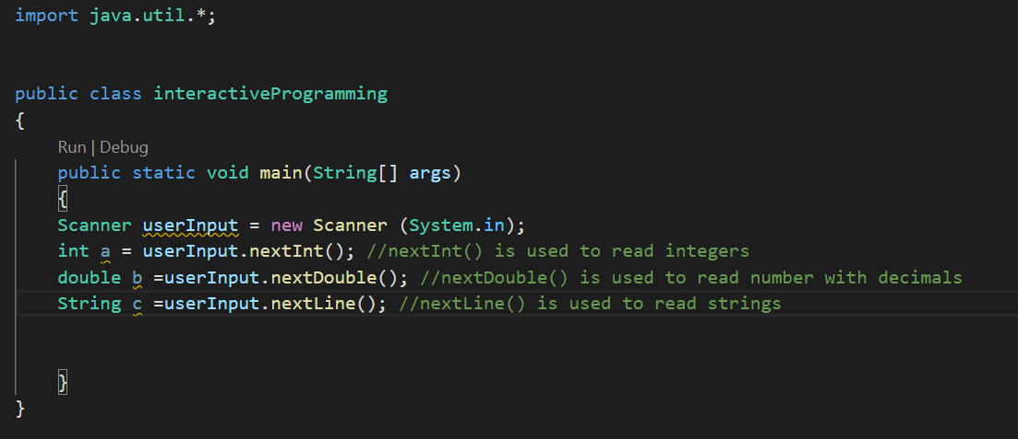
Scanner class

Slide 3
import
Key word that allows to use pre-written code
When using the Scanner class we import the utilities package hence the line import java.util.*
The asterisk * is a special character used in file names that means “get everything from this folder/package
Some more packages in the utility package include: Timer, Currency, Random

Slide 4
Using the scanner class
We create a new object in a similar way we do with other classes:
Scanner userInput = new Scanner(System.in); //we declare a variable of type // scanner and give it the name userInput
//the variable is assigned an object of type Scanner and we tell it that it //will be getting inputs

Slide 5
Common methods for Scanner objects
nextInt(); - Read an integer value
nextDouble(); - Read a double value
nextLine(); Read a string

